Slide 1
بسم الله و الصلاه والسلام على رسول الله (صلي الله عليه وسلم) : نقدم لكم

Slide 2

PicStar Project
Frontend Web Project

Slide 3

The Idea
# Hi, This project is a summer self chosen project .
# Made by Ayatallah Ashraf & Basmala Usama.
# Mainly it is about a similar web to Instagram.
# Started at 1/7/2024 and its discussion day is 14/7 .

Slide 4
The Web Sections
Home Page
Chats and Stories
Search
Reels
Post a Post
Profile
Log in / Sign in
Friends profiles
Mohammed Sobhy

Slide 5
Aya's Pages :
Home Page
Search
Post a Post

Slide 6
Basmala's Pages
Reels
Chats & Stories
Profile
Friends Profile
Log in / sign in

Slide 7


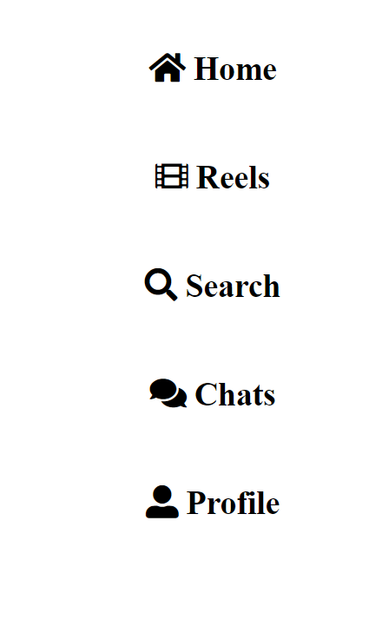
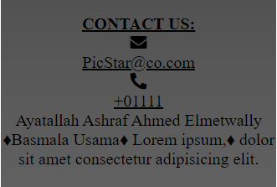
Common Parts:
1- internal logo
2- external logo
3- nav. Par
4- footer

Slide 8
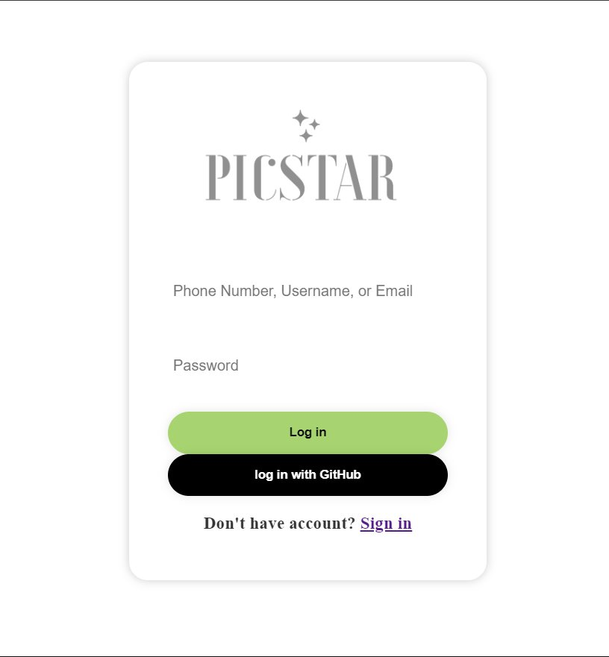
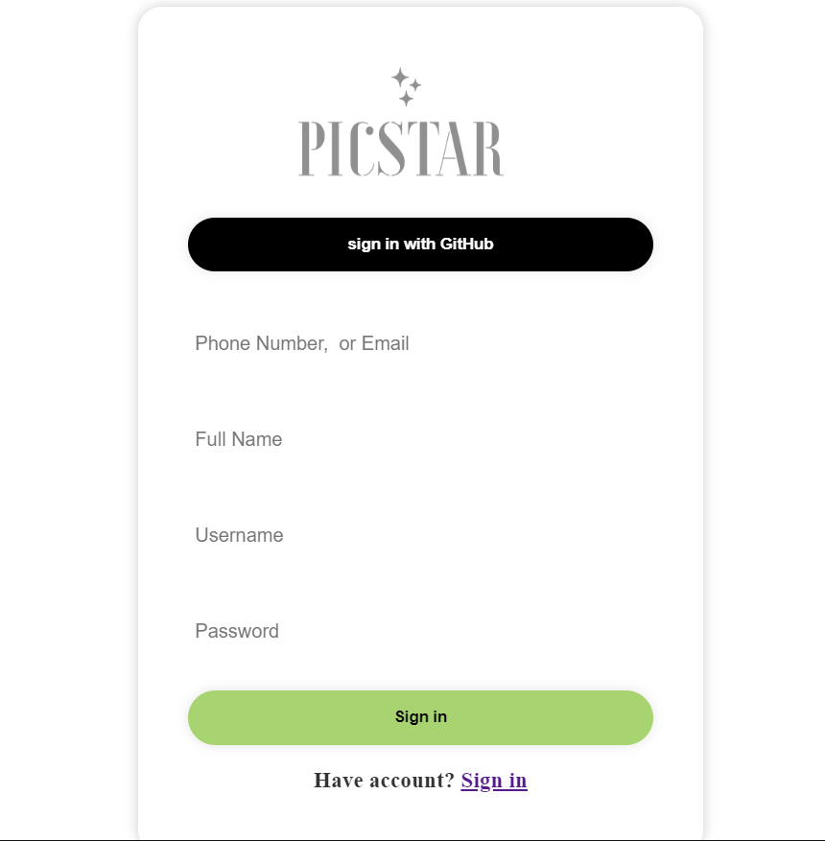
Register & Log in.
You can easily register or login our website to communicate with all of your friends and follow all your celebrities !

Slide 9
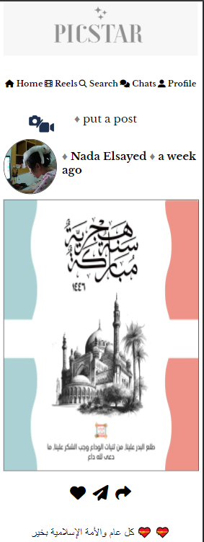
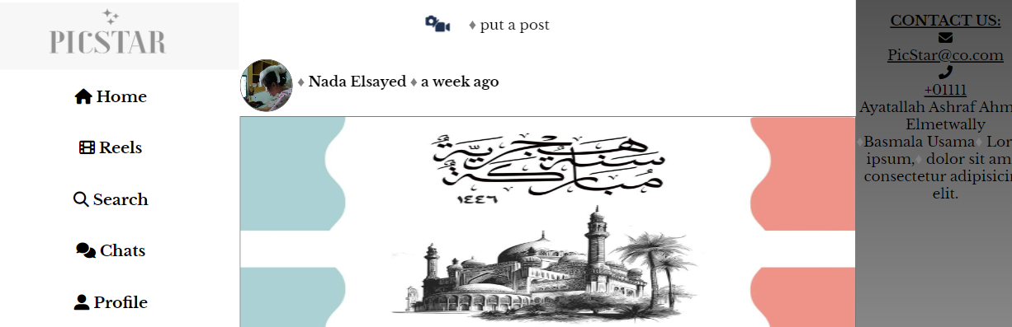
Home Page

Slide 10
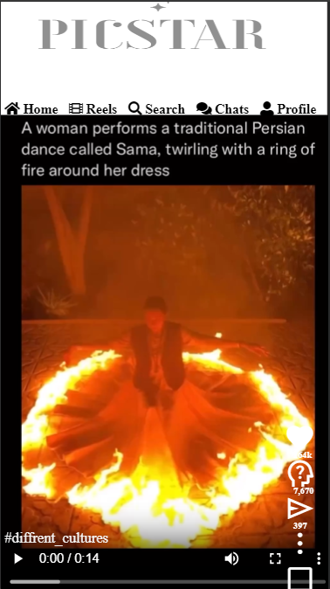
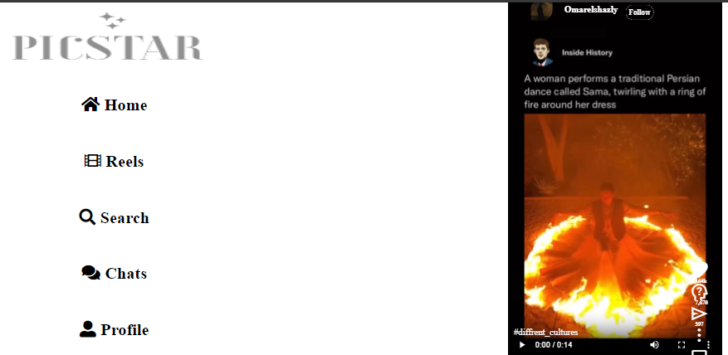
Reeels

Slide 11
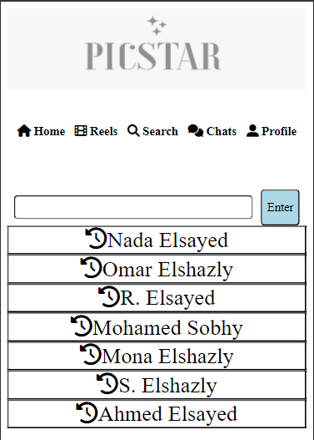
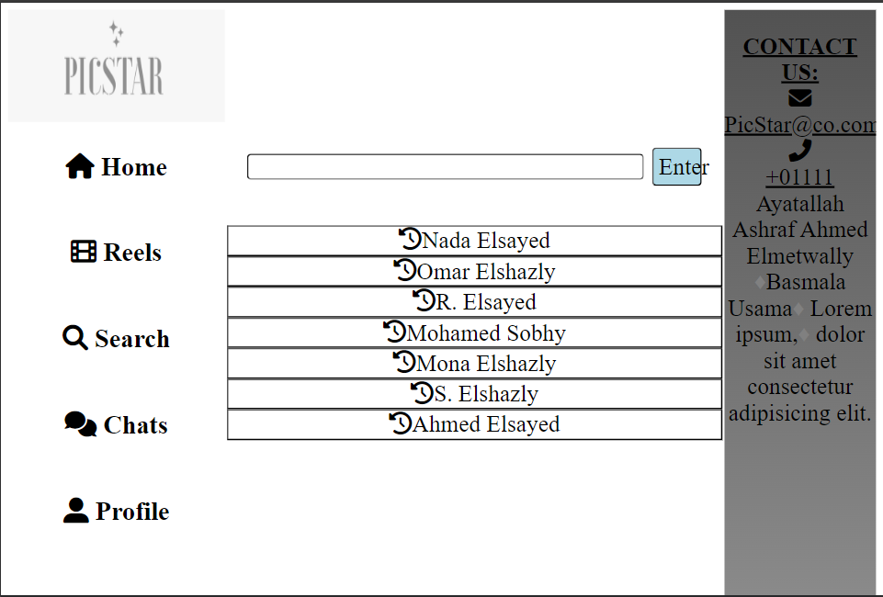
Searching...
Click on the old results to see the new result.

Slide 12
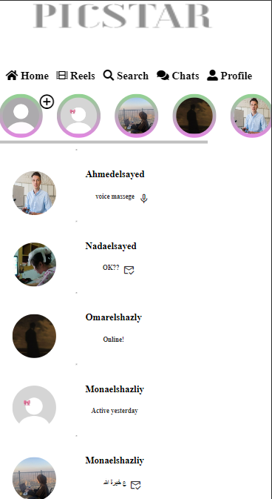
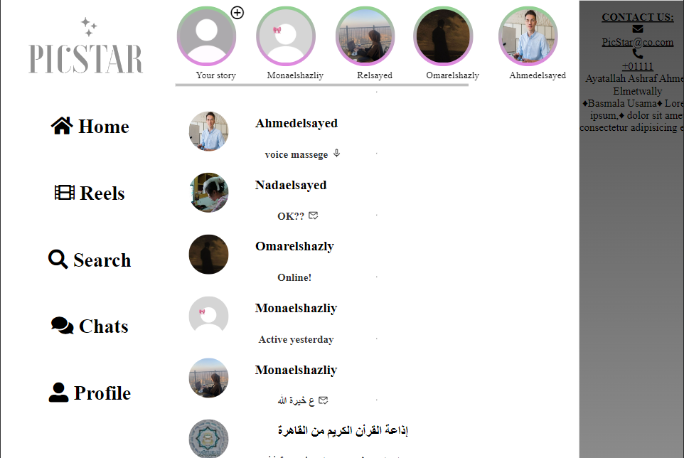
Chatting !!
Click on your story to add one.

Slide 13
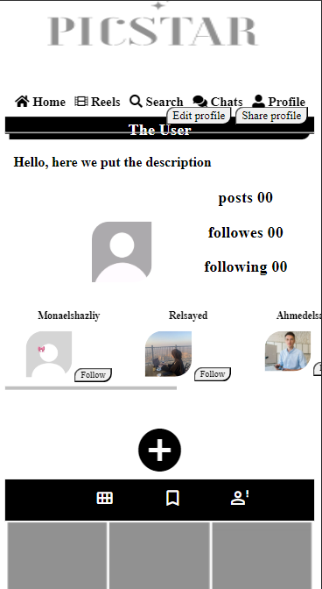
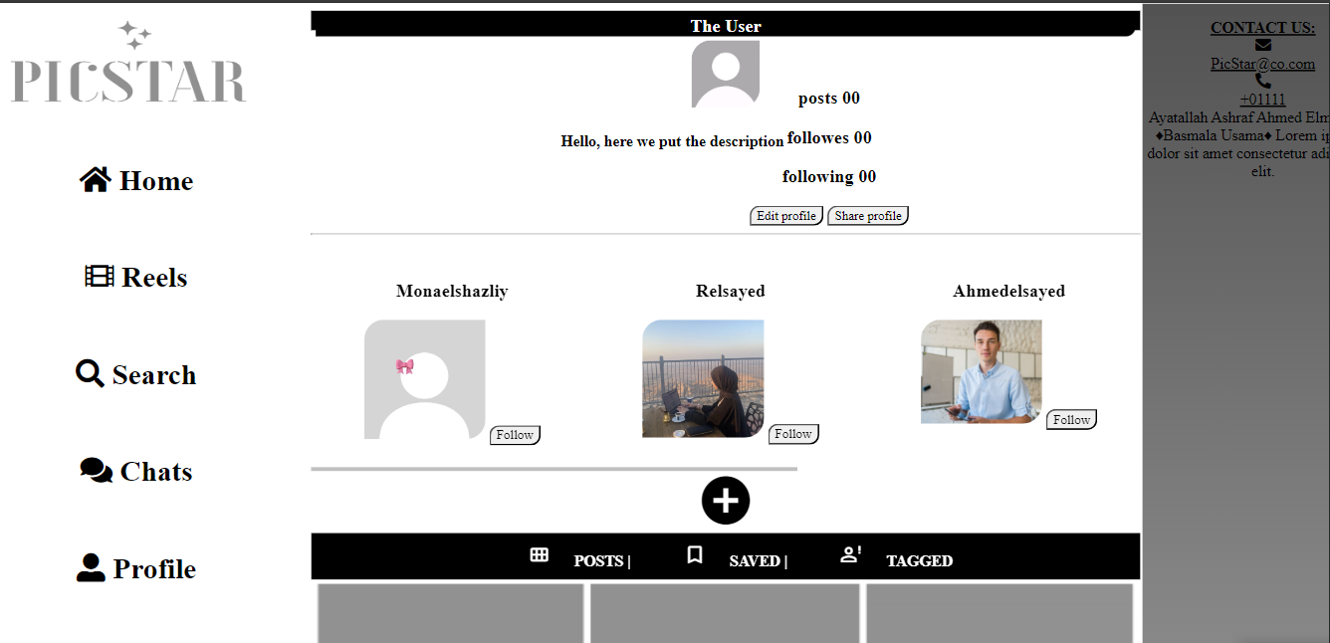
You?!
Click on the name in the discover to see the account (only if it is active).

Slide 14
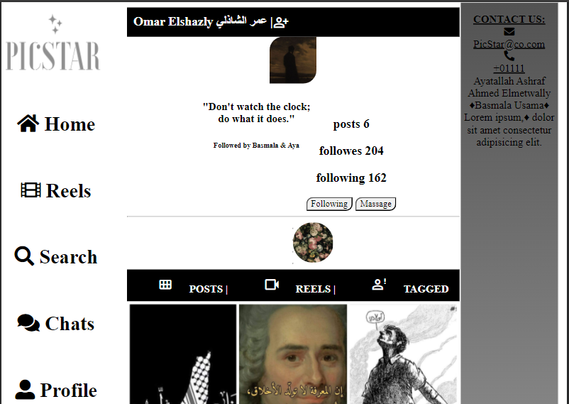
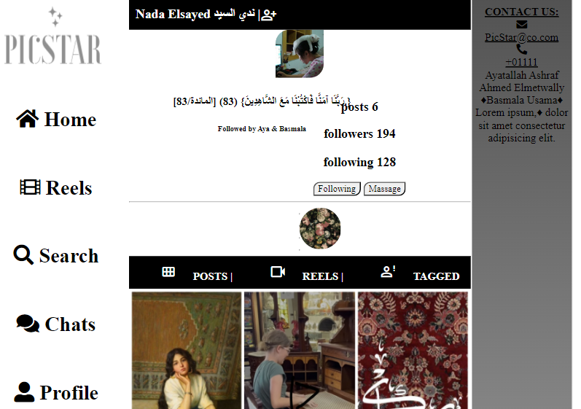
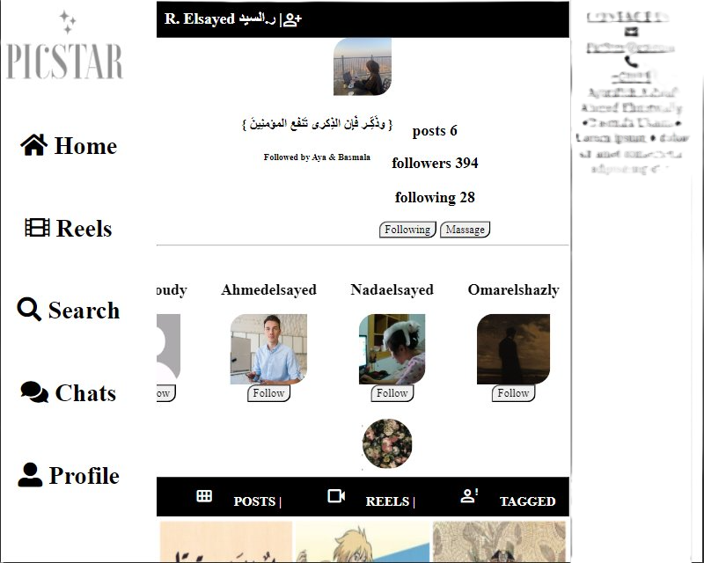
~Mes Amis
Those 3 are the only active accounts that you can click on & the icon next to their names opens the discover section (click on the name to see the profile ).

Slide 15
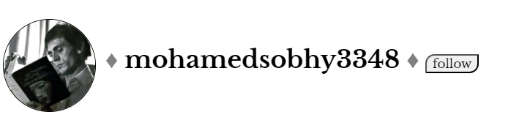
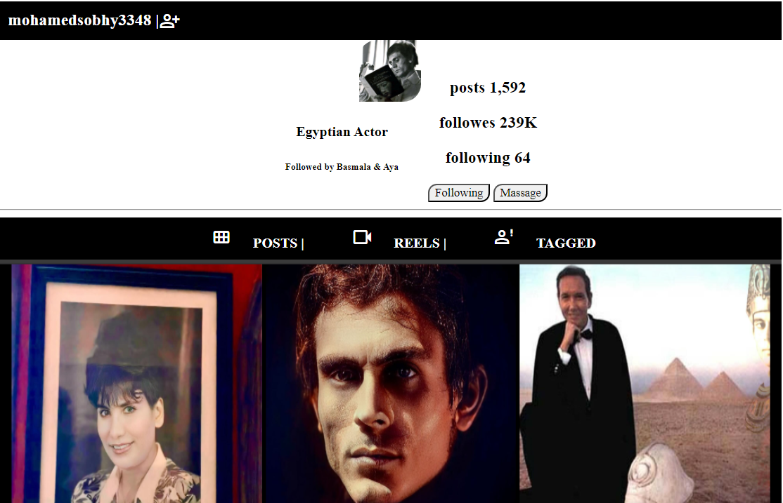
The Only Active Celebrity Profile
The only way to see it is from his post on the home page.

Slide 16
سبحانك اللهم وبحمدك
Made by B.U.

